Slide 1

Chapter 4
Communication in DS
DISTRIBUTED SYSTEM

Slide 2

Objectives
After accomplishing this chapter, Students will be able to understand:
Introduction to Communication
Network Protocols and Standards
Remote Procedure Call(RPC)
Remote Method Invocation (RMI)
Message-Oriented Communication
Stream-Oriented Communication
Multicast Communication

Slide 3
What is Communication?
Inter process communication is at the heart of all distributed systems.
Communication in distributed systems is based on message passing as offered by the underlying network which is harder as opposed to using shared memory.
Modern distributed systems consist of thousands of processes spread across an unreliable network such as the Internet.
Unless the primitive communication facilities of the network are replaced by more advanced ones, development of large scale Distributed Systems becomes extremely difficult.

Slide 4
Network Protocols and Standards
Why communication in distributed systems? because there is no shared memory.
Two communicating processes must agree on the syntax and semantics of messages which defined as protocol.
A protocol is a set of rules that governs data communications and defines what is communicated, how it is communicated, and when it is communicated.

Slide 5
Cont…
One computer to send a message to another computer, the first computer must perform the following general steps (highly simplified).
Break the data into small sections called packets (message, datagram, packet, frame).
Add addressing information to the packets identifying the source and destination computers.
Deliver the data to the network Interface Card for transmission over the network.

Slide 6
Cont…
The receiving computer must perform the same steps, but in reverse order.
Accept the data from the NIC,
Remove transmitting information that was added by the transmitting computer,
Reassemble the packets of data into the original message.
The key elements of a protocol are syntax, semantics, and timing
Syntax: refers to the structure or format of the data.
Semantics: refers to the meaning of each section of bits.
Timing: refers to when data should be sent and how fast they can be sent functions of protocols.

Slide 7
Network (Reference) Models
Layers and Services
Within a single machine, each layer uses the services immediately below it and provides services for the layer immediately above it.
Between machines, layer x on one machine communicates with layer x on another machine.
Two important network models or architectures are ISO OSI (Open Systems Interconnection) and Reference Model.
[A. The OSI Reference Model consists of 7 layers]
Open to connect open systems or systems that are open for communication with other systems.

Slide 8
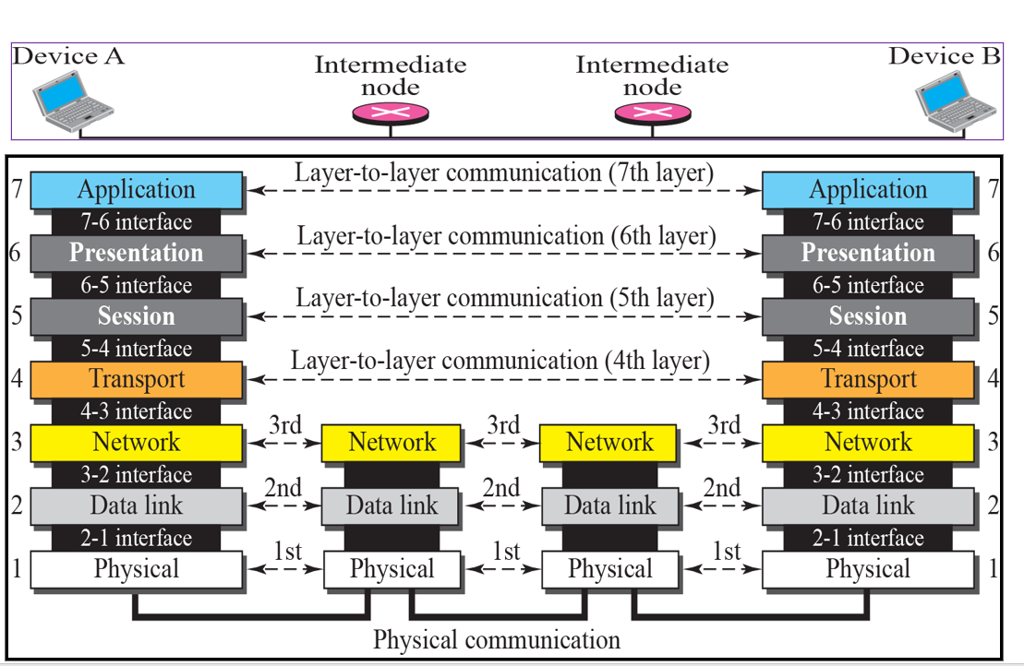
Cont…

Slide 9
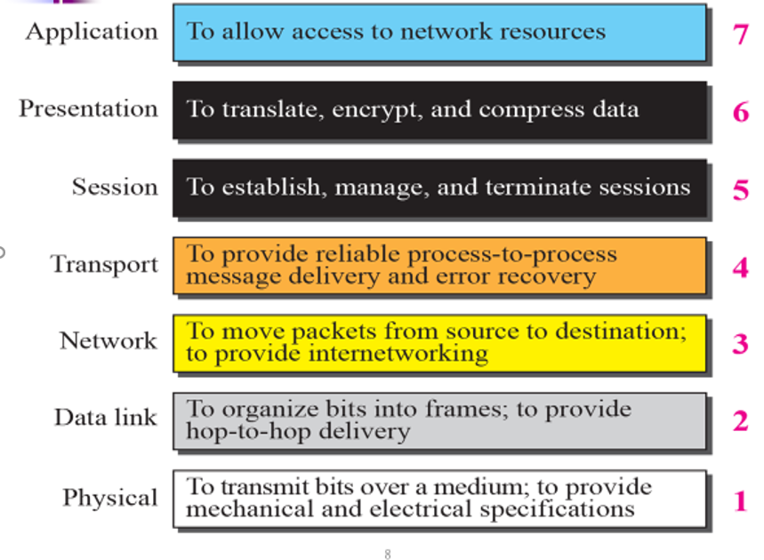
Function of Each Layer

Slide 10
How To Communicate?
To create the communication between components, or objects of distributed system:
Remote Procedure Call(RPC)
Remote method invocation (RMI)
In RPC and RMI
Senders-receivers of messages
Coexist at the same time
are aware of each other’s identities
Indirect communication
Senders do not need to know who they are sending to ( space uncoupling)
Senders and receivers do not need to exist at the same time ( time uncoupling)
Key techniques in indirect communication:
Group communication
Publish-subscribe systems

Slide 11

Remote Procedure Call(RPC)
In distributed computing, Remote Procedure Call (RPC) is a protocol that one program can use to request a service from a program located in another computer on a network.
RPC may be a message-passing programming technology developed by Sun Microsystems and extended by the Open Software Foundation (OSF) that enables an application to execute procedures and interact with services on a remote computer on the network.
A procedural language is a type of computer programming language
that specifies a series of well-structured steps and procedures within
its programming context to compose a program.

Slide 12
Cont…
A Remote Procedure Call is an inter-process communication technique that is used for client-server based applications and it is also known as a function call.
Remote Procedure Call is a technique for building distributed systems and basically, it allows a program on one machine to call a subroutine on another machine.
RPC is not a transport protocol: rather, it is a method of using existing communications features in a transparent way.

Slide 13
Cont….
RPC mechanisms are used when a computer program causes a procedure or subroutine to execute in a different address space, which is coded as a normal procedure call.
Remote Procedure Call (RPC) is a powerful technique for constructing distributed, client-server based applications.
It is based on extending the conventional local procedure calling so that the called procedure need not exist in the same address space as the calling procedure.

Slide 14
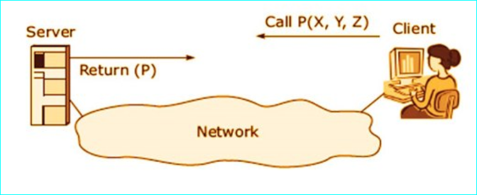
Cont…
RPC are essential to the development of distributed systems because they let programmers extend the capabilities of conventional procedure calls across a network.

Slide 15
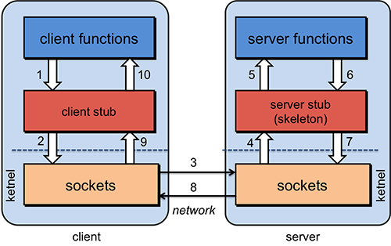
RPC Steps

Slide 16
Cont…
Client procedure calls client stub in the normal way
Client stub builds a message and calls the local OS
Client’s OS sends the message to the remote OS
Remote OS gives the message to the server stub
Server stub unpacks the parameters and calls the server
6. Server does the work and returns the result to the stub
7. Server stub packs it in a message and calls the local OS
8. Server’s OS sends the message to the client’s OS
9. Client’s OS gives the message to the client stub
10. Stub unpacks the result and returns to client

Slide 17
Remote Method Invocation(RMI)
In a distributed computing environment, distributed object communication realizes communication between distributed objects.
The main role is to allow objects to access data and invoke methods on remote objects (objects residing in non-local memory space).
Invoking a method on a remote object is known as remote method invocation (RMI) or remote invocation, and is the object-oriented programming.

Slide 18
Cont…
RMI is a way that a programmer, using the Java programming language and development environment, can write object-oriented programming in which objects on different computers can interact in a distributed network.
RMI is the Java version of what is generally known as a remote procedure call (RPC), but with the ability to pass one or more objects along with the request.
The object can include information that will change the service that is performed in the remote computer.

Slide 19
Cont…
An object encapsulates data, called the state, and the operations on those data, called methods
Methods are made available through an interface and the state of an object can be manipulated only by invoking methods.
This allows an interface to be placed on one machine while the object itself resides on another machine, such an organization is referred to as a distributed object.

Slide 20
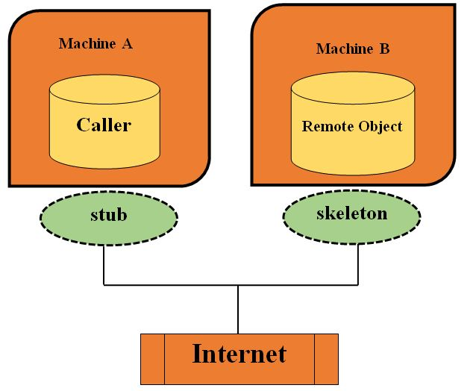
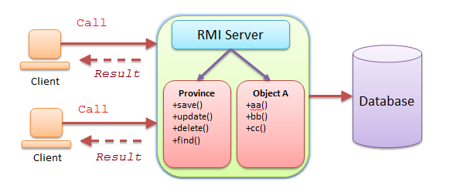
Cont…

Slide 21
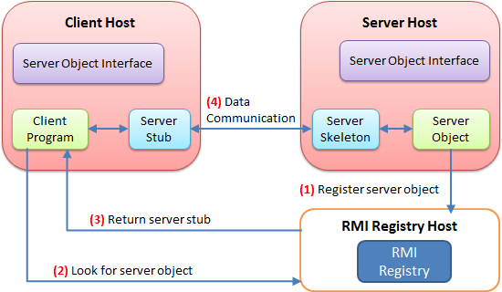
Steps of RMI

Slide 22
RPC Vs. RMI
RPC and RMI are the mechanisms which enable a client to invoke the procedure or method from the server through establishing communication between client and server.
The common difference between RPC and RMI is that RPC only supports procedural programming whereas RMI supports object-oriented programming.
Another major difference between the two is that the parameters passed to remote procedures call consist of ordinary data structures.

Slide 23
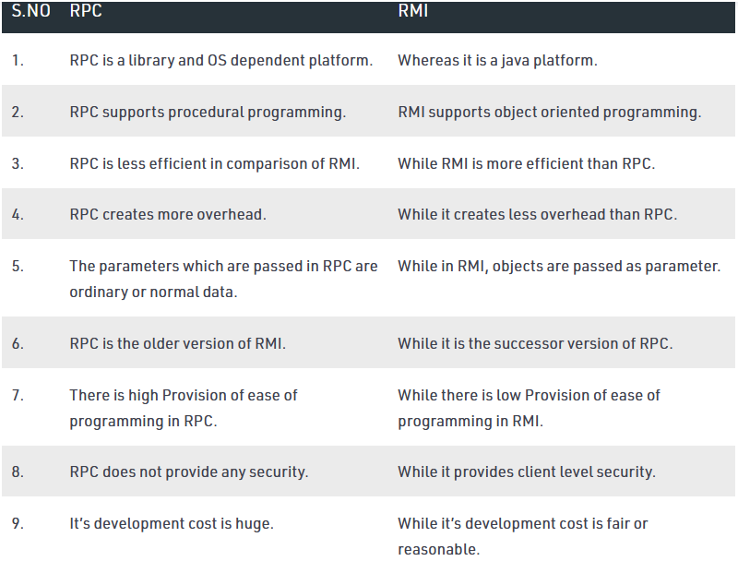
Cont…

Slide 24
Socket Programming
Socket Programming is a way of connecting two nodes on a network to communicate with each other.
One socket(node) listens on a particular port at an IP, while other socket reaches out to the other to form a connection.
Server forms the listener socket while client reaches out to the server.
Sockets are a fundamental part of client-server networking and they provide a relatively easy mechanism for a program to establish a connection to another program, either on a remote or local machine and send messages back and forth.

Slide 25
Cont…
Socket programming refers to communication between two nodes or applications running on different JRE (Java Runtime Environment).
We use the socket programming in Java to connect the client program with the server program, or simply, connect a client and a server.
A socket programming interface provides the routines required for interprocess communication between applications, either on the local system or spread in a distributed, TCP/IP based network environment.
Once a peer-to-peer connection is established, a socket descriptor is used to uniquely identify the connection.

Slide 26
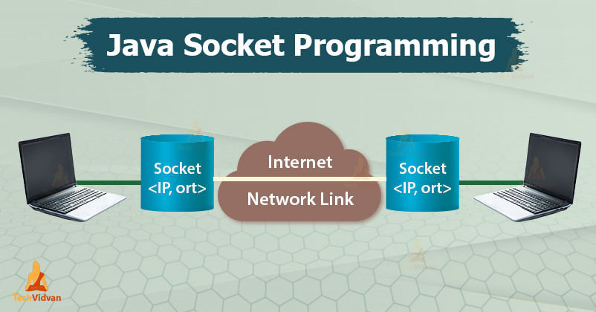
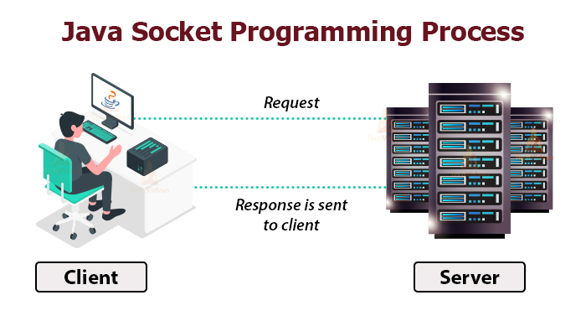
Cont…

Slide 27
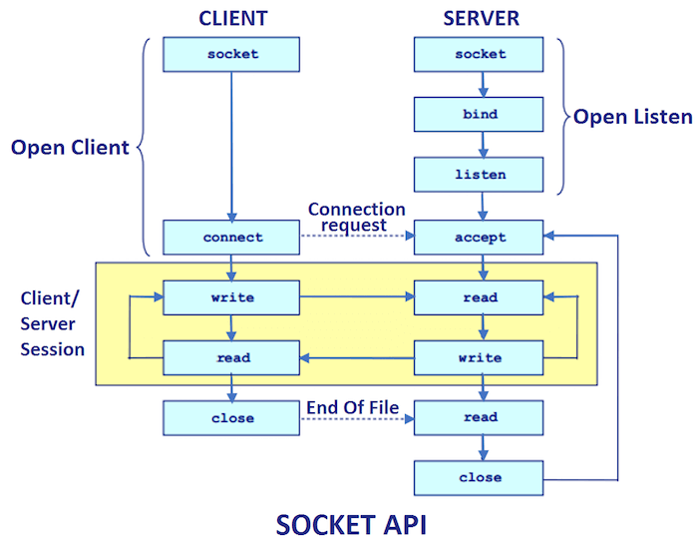
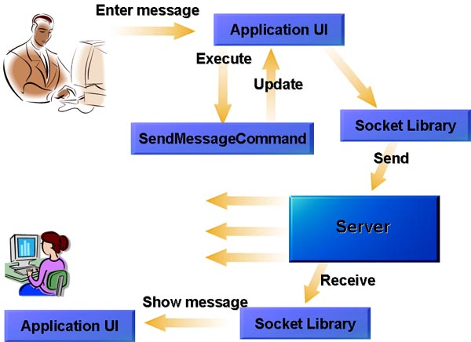
Cont…

Slide 28
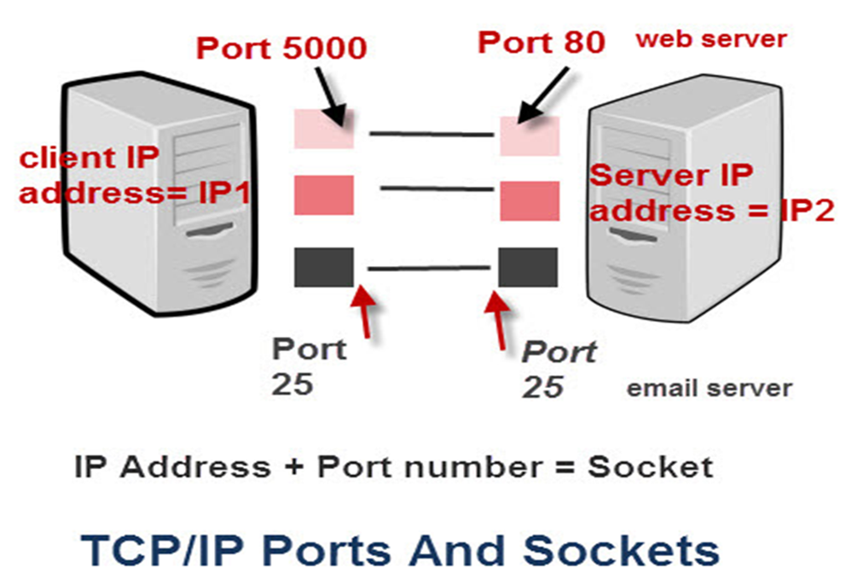
Client- Side Socket Programming
For implementing client-side programming, we need to follow the below steps:
Create a Socket(Socket s=new Socket(“IP",Port Number);)
Connect it to ServerSocket by specifying the IP address and the port number
Get the reference of the OutputStream
Attach this reference to OutputStreamWriter
Write(out.write();) and close(out.close();)
Get the reference of InputStream
Attach this reference to InputStreamWriter
Read and Buffer
Parse, interpret and process it
Close Connection

Slide 29
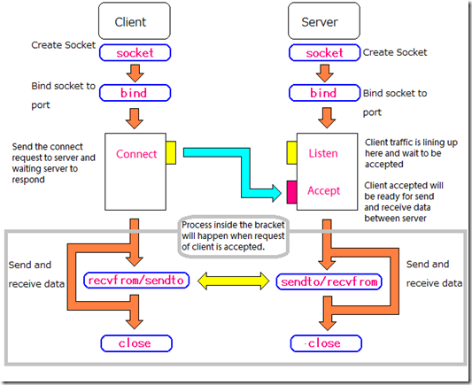
Server- Side Socket Programming
For implementing server-side programming, we need to follow the below steps:
Create ServerSocket
Bind it to a port number
Put it into the listening mode
Get the reference of Input Stream
Attach the reference to InputStreamReader
Read and buffer
Parse the request
Prepare response
Get the reference of OutputStream
Attach the reference to OutputStreamReader
Write the response
Close Connection

Slide 30
Message-Oriented Communication
RPCs and RMIs are not adequate for all distributed system applications.
The provision of access transparency may be good but they have semantics that is not adequate for all applications.
Example problems
They assume that the receiving side is running at the time of communication.
A client is blocked until its request has been processed messaging is the solution

Slide 31
Cont…
Until now, we focused on exchanging independent and complete units of information
Time has no effect on correctness; a system can be slow or fast, however, there are communications where time has a critical role.
Media
Storage, transmission, interchange, presentation, representation and perception of different data types like text, graphics, images, voice, audio, video, animation, ... movie: video + audio + …
Multimedia: Handling of a variety of representation media
End user pull
Information overload and starvation/Hunger
Technology push
Emerging technology to integrate media

Slide 32
Cont…
As seen so far, Communication has concentrated on exchanging independent and complete units of information.
Stream-oriented communication is a form of communication in which timing plays a crucial role. E.g. audio stream.
Support For Continuous Media • Medium - means by which information is conveyed.
Includes storage and transmission media, presentation media such as a monitor, and so on.
Temporal relationships between different data items are fundamental to correctly interpreting what the data actually means.

Slide 33
Cont…
DATA STREAM: A data stream is nothing but a sequence of data units and Different transmission modes:
Asynchronous Transmission Mode: The data items in a stream are transmitted one after the other, but there are no further timing constraints on when transmission of items should take place.
•For example, a file transferred as a data stream.
Synchronous Transmission Mode: There is a maximum end-to-end delay defined for each unit in a data stream.
Whether a data unit is transferred much faster than the maximum tolerated delay is not important.

Slide 34
Multicast Communication
Modern applications are required to handle and communicate an increasing amount of data.
Meanwhile, distributed systems containing multiple computationally weak components becomes more common, resulting in a problematic situation.
Choosing among communication strategies, used for delivering message between entities, therefore becomes crucial in order to efficiently utilize available resources.
Systems where identical data is delivered to many recipients are common nowadays, but may apply an underlying communication strategy based on direct interaction between sender and receiver which is insufficient.

Slide 35
Cont…
Multicasting refers to a technique for group communication where messages can be distributed to participating nodes in a single transmission.
This technique is developed to avoid the problem of high workload on sender side and redundant traffic in the network, and constitutes the focus.
Multicasting refers to the communication paradigm where delivery of messages goes from one sender to multiple receivers.

Slide 36
Cont…
It has the benefit of providing message delivery to a destination group in a single transmission, as messages are replicated on network elements, i.e. routers and switches.
This means that only one message needs to be sent on each link in the network which can decrease the amount of copies on the outgoing link for this thesis.

Slide 37
Group Project (20%)
Group 1: Develop android Apps for group Chat using Java RMI.
Group 2: Develop android apps for P2P Chat using Java RMI.
Group 4: Develop android apps for multicast Chat using Java RMI.
Group 4. Develop android based group Chat App using Sockets programming.
Group 5: Develop Real-time Chat Application using Java RMI or other
Note.
Group Member must be 5-10.
Present your work by Install the developed apps on your phone.
Presentation date is January 30/2022 G.C

Slide 38
THANK YOU!!!
QUESTIONS???

